Slide 1

The Dissertation Writing Process
Navigating
The
Experience
Presented by Mfon Nwabuoku
Notes:
NOTE:
To change the image on this slide, select the picture and delete it. Then click the Pictures icon in the placeholder to insert your own image.

Slide 2
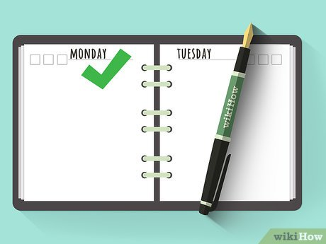
Make a Schedule
Schedule time to write/ work on your dissertation
Don’t be afraid to change the schedule to suit you
Find your best fit.
Work with deadlines/timelines.
8.00 am – 10.00 am Write
6.00 pm – 8.00 pm Write

Slide 3
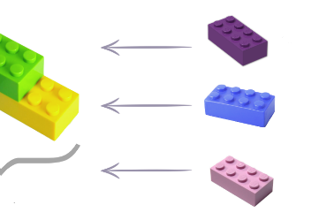
Make a Schedule
Schedule time to write/ work on your dissertation
Don’t be afraid to change the schedule to suit you
Find your best fit.
Work with deadlines/timelines.

Slide 4


Slide 5
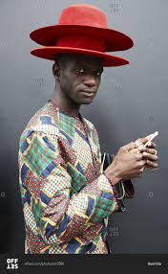
It helps to wear just one hat at a time…

Slide 6

Use your support system
Your committee
Family/friends
Peers
Professional

Slide 7
Use your support system
Your committee
Family/friends
Peers
Professional

Slide 8

Feedback is Important
Get feedback
Use feedback

Slide 9

Be flexible

Slide 10


