Slide 1
Strategies for managing writer’s block
Dr. Kelsie Endicott

Slide 2
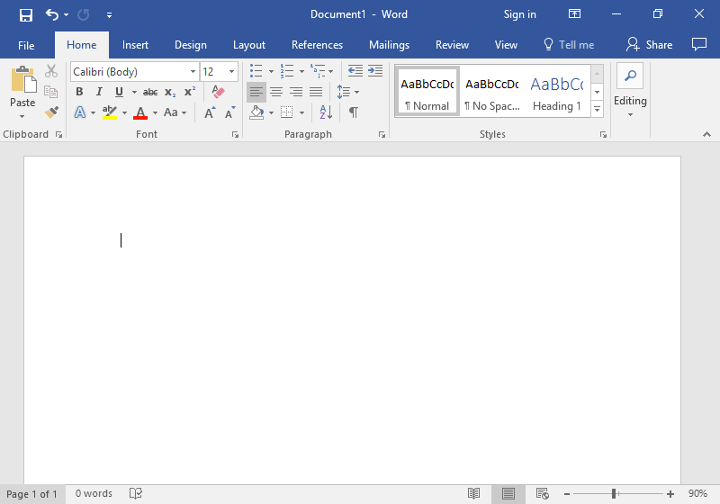
Let’s talk about writer’s block
We all know what writer’s block is, but let’s take an expanded view of it. Let’s frame it as a thinking block.
Activity: spend the next few minutes writing and reflecting on the following:
Have you experienced writer’s block before? If not, what do you think might cause you to experience writer’s block?

Slide 3
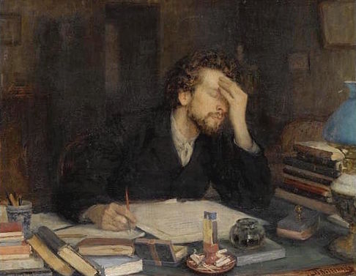
Let’s talk about writer’s block
Why do you think you experienced writer’s block? What are your triggers?

Slide 4
Let’s talk about writer’s block
How often do you experience writer’s block?

Slide 5
Let’s talk about writer’s block
Think about what was going on in your life when you had writer’s block. Write down your circumstances.

Slide 6
Let’s talk about writer’s block
If you overcame writer’s block, how did you do it?

Slide 7
Common Causes of Writer’s Block
Feeling like you don’t have enough time to write/tight deadlines
Working in an environment that isn’t conducive to writing
Not knowing your writerly self and what works for you
Negative self-talk/future tripping
Not knowing where to start/what to write about
Recalling negative writing/feedback experiences
Not knowing how to respond to feedback/hesitancy to revise
Unfamiliar with the genre
Not understanding the reading/concept
Having too much time to write/distant deadlines
Perfectionism paralysis
Having “writing rules”
Loss of momentum/flow/interest in project

Slide 8
Having “writing rules”
Working in an environment that isn’t conducive to writing
Not knowing your writerly self and what works for you as a writer
Negative self-talk/inability to silence your “inner editor”/imagining a negative outcome
Recalling negative writing experiences/feedback experiences
Not knowing how to respond to feedback/hesitancy to revise
Not knowing where to start/what to write about
Being unfamiliar with the genre you’re being asked to write in
Not understanding what you read/not understanding a concept
Feeling like you don’t have enough time to write/a writing deadline is too tight
Feeling like you have too much time to write/a writing deadline is distant
Being paralyzed by perfectionism
Loss of momentum or “flow”/loss of interest in the piece/project

Slide 9
Suggestions for coping with writer’s block
All of the following suggestions require you to do some self-monitoring of your thinking and writing habits.

Slide 10
“Writing rules”
If you struggle with self-imposed writing rules, break them (but maybe not all at once).
Questions you might ask yourself as your break your rules:
  How did it feel to break them?
  What was the effect of breaking the rules (personally and regarding the writing process and product)?
  Is this something I’d like to continue doing or is there another “rule” I need to try breaking?
Recommended reading: Mike Rose’s “Rigid Rules, Inflexible Plans, and the Stifling of Language: A Cognitivist Analysis of Writer’s Block”

Slide 11
Writing environment
Assess your writing environment and adjust accordingly.
  Is it too loud? Too quiet?
  Is it filled with distractions?
  Is it not the right time of day for you?
  What is your ideal writing environment? How comfortable (or uncomfortable) do you need to be to write?
  Do you need food or a drink when you’re writing?
  If you are using a computer, do you have too many tabs open? Too many notifications? Too much access to social media?

Slide 12
Getting in touch with your writerly self
If you struggle with knowing the writerly part of yourself, then some identity works is needed.
Writing is always identity work.
First, embrace the fact that you are a writer.
Second, embrace the fact that you are a scholar.
At this moment, take inventory of who you are as writer, meaning, think about what your writing process is as a scholar. What did it used to be? How has it changed (if it has changed)? What are your writing preferences?

Slide 13
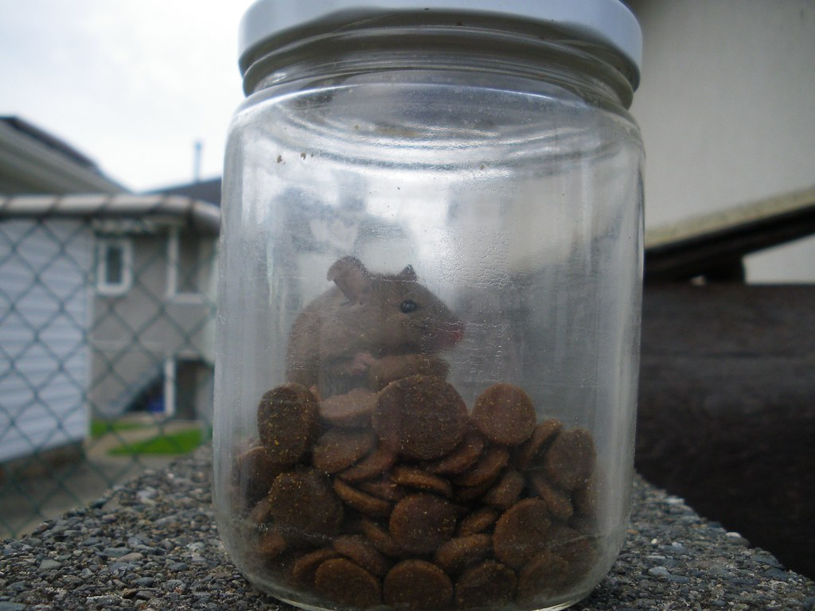
Negative self-talk/loud inner critic/editor
If you suffer from negative self-talk or you can’t turn off your “inner editor” while writing, then you might want to try doing the following:
Talk back to your thoughts. Question/challenge them. Where is this negativity really coming from?
Tell your “inner editor” that you’re in the drafting phase right now and their editorial remarks are not necessary at this stage.
Imagine your negative thoughts are like mice. Grab each mouse (negative thought) by the tail and drop it into a mason jar until your mind is quieted.
Imagine a positive outcome.
Recommended reading: Anne Lamott’s “Shitty First Drafts”

Slide 14
Dwelling in the past
If your trouble is recalling bad writing/feedback experiences, then remind yourself that they need to go back to where they belong—the past. Unless you are learning something useful from them, then they have no place in the present or future.
You can also try counter them by reminding yourself of positive feedback/writing experiences. Why were they positive? If possible, apply the same writing moves you used to succeed in the past to the present assignment.

Slide 15
Feedback/hesitancy to revise
If you’re stuck because you’re not sure how to respond to feedback you’ve been given and/or you’re hesitant to revise, then you have a few options:
  Ask the person who gave you the feedback to tell you what they meant by it (this isn’t going to be as painful as you think it is)
  Revising is tough—acknowledge this, then begin revising.
  Maybe you’re someone who needs to revise the easiest suggestion first to get you into “revising mode”, or in contrast, maybe you need to revise the more substantial suggestions first (this is normally what I would recommend doing).
  Perhaps you need to read through all of the comments and rank them according to what needs to be revised first. You may even notice a pattern or theme in the comments that can help inform you as to which ones to tackle first.
  You have the right and the power to not take suggestions (just discern which ones to pass over and which to revise).

Slide 16
Where/how to begin?
If you’re having trouble getting started to write, maybe you’re not ready to write yet.
You may need to do additional research, outlining, planning to get a better sense of what you need before you begin writing.
Review the prompt/assignment closely.
Ask your professor to clarify the assignment.
Have a brainstorming session (individually, with your professor, with me).

Slide 17
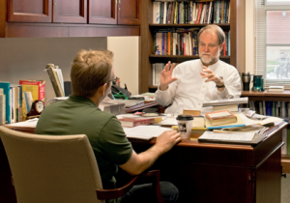

Unfamiliar with the genre
If you’re not sure of the genre, or how you’re supposed to write the paper, the best thing to do is talk with your professor. Ask them to describe the goals of the paper and see if they will discuss features of the genre with you.
Ask your professor to see a model paper that you can use to help you write.

Slide 18
Difficult readings/theories/concepts
You may have writer’s block if you didn’t understand course readings or concepts.
Academic writing can be hard to parse, so it’s okay to walk away a bit confused about what you read.
Seek out your professor or a class mate and ask them how they interpreted it.
Come to the GWC and we can review the reading together.
Maybe you need to employ some reading and notetaking strategies.

Slide 19
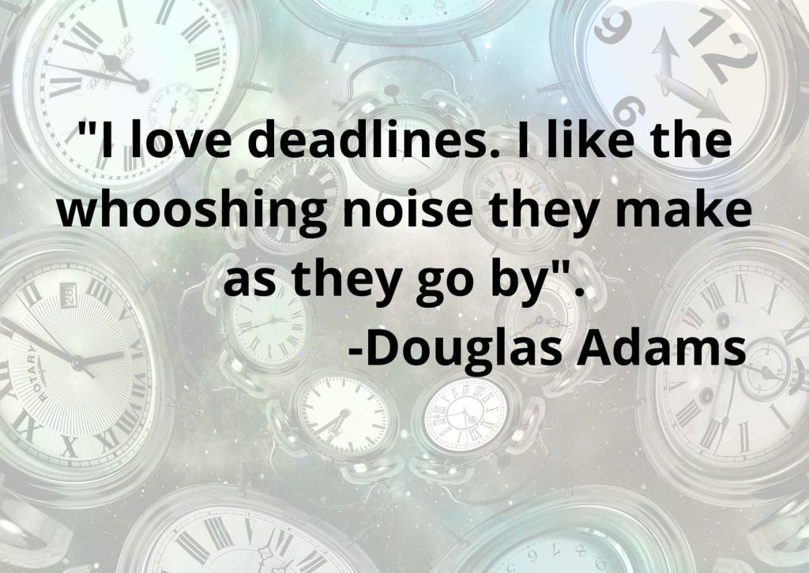
Time constraints
You might struggle with writer’s block if you feel you don’t have enough time to write or if a deadline is too tight.
You can ask your professor to move the deadline (but be ready and able to show proof of progress on your assignment and offer a specific, realistic deadline that you think you can meet).
Instead of focusing on the deadline, make a task list that you need to accomplish before you reach that deadline and focus on the individual tasks instead.

Slide 20
Distant deadlines
Perhaps an approaching deadline isn’t problematic, rather it’s motivating. If this sounds like you, maybe you do better with working under pressure.
Procrastination is never good, especially when working on an advanced degree because the stakes are so high as is the workload, so don’t wait ‘til the last minute to do your writing.
Instead, set yourself mini, tighter deadlines that will help you more steadily and consistently reach your goals rather than waiting ‘til the critical end.
If accountability is motivating to you, then give these mini-deadlines to someone that will hold you accountable for meeting them when you say you will.

Slide 21
Perfectionism paralysis
If you tend toward being a perfectionist, you’ve probably already realized that mindset doesn’t work when you’re earning an advanced degree (really, it doesn’t ever work).
Why doesn’t perfectionism work?
  You have more work and less time to do it.
  No one expects you to turn in perfect work, they expect good, quality work, but not perfect work (perfection doesn’t exist).
  What you write today, you might interpret differently years from now.
  Research is ongoing and changes, along with public opinion, so nothing you write will ever be finite in that sense.

Slide 22
Loss of momentum/flow/interest
You may suffer from writer’s block if you’ve lost momentum/flow/interest.
If you’ve lost these things, spend some time recalling why you were interested in the topic/writing project in the first place. Sometimes reminding yourself of this will help you get back into the work.
If you’re worried about losing momentum/flow, then try stopping mid-way through a sentence so that you know you have to come back to it. If you don’t want to stop mid-way through your sentence, then finish it and leave yourself a note about where you plan to go next.
Don’t take too long a break from your work.
Reverse outline (summarize each section) to decide if there really is some disorganization going on. Once you’ve identified, re-order your sections. This is a gentle way to get you back into the work as well.

Slide 23
Downshifting: Next steps for coping with writer’s block
What triggers your writer’s block?
What strategies will you try the next time you experience, or feel when you’re about to experience writer’s block?

Slide 24
Resources/Citations
https://wwwcp.umes.edu/grad/graduate-writing-center/
Anne Lamott: “Shitty First Drafts”
Mike Rose: “Rigid Rules, Inflexible Plans, and the Stifling of Language: A Cognitivist Analysis of Writer’s Block”
Donald M. Murray: “All Writing is Autobiography”

